Slide 1
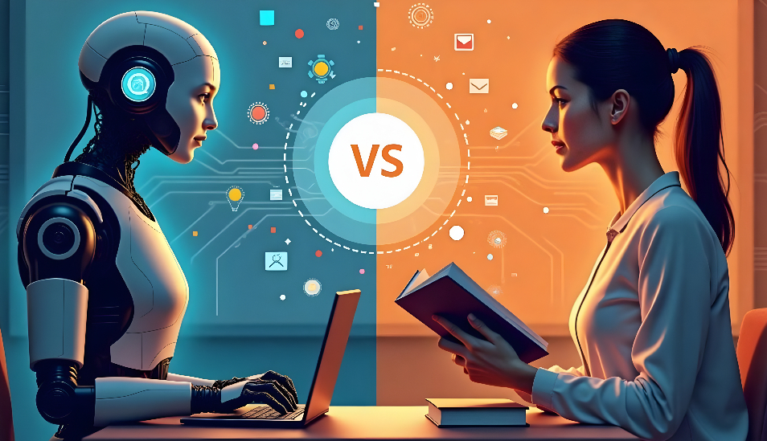
AI vs HUMAN TEACHING
What Do Students Prefer?

Slide 2
Group Members:
Maham Zafar (182)
Muhammad Ahmed Chaudhry (184)
Nabeeha Shoaib (190)
Isma Wasif (226)
Anfaal Abbas (233)
Instructor:
Ms. Ramsha Khalid
Application of Information and Communication Technologies Lab
Fall 2025
Section D

Slide 3
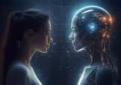
PUrPose of STUDY
With the rise of AI tools, education is transforming rapidly. This study is particularly aimed to find if students prefer between AI-based teaching or human teaching methods.

Slide 4
SURVEY DETAILS
PLATFORM USED FOR SURVEY
Google Forms
10 questions asked in the survey.
21 responses recorded in survey.
Undergraduate students from first to fourth year were reached to get their feedback.
KEY QUESTIONS ASKED IN SURvey
Does students use AI-powered tools for learning?
How effective students rate AI and Human teachers for learning?
What does the students think about future teaching model?

Slide 5

AI Tools in Student Learning
Most Popular AI Tools
ChatGPT
Google Gemini/Bard
Youtube AI
Grammarly
19%
81%
AI tools are becoming popular among students

Slide 6
Effectiveness Ratings:
AI vs Human Teachers:
Students rated AI based learning slightly higher (average rating 3.81/5) than human teaching (average rating 3.76/5)
This indicate that while human teaching is viewed as effective for understanding complex concepts, AI is getting appreciated due to its convenience and accessibility.
3.76
3.81

Slide 7
STUDENTS Learning preferenceS
Despite similar effectiveness ratings, students trust human teachers more for understanding difficult topics.
19%
57%
24%

Slide 8

ideal teaching model for the future
Most students prefer human based teaching or human-AI combination.
This shows students prefer hybrid education over pure AI, indicating human essentiality in education.
24%
40%
36%

Slide 9
What Makes Human Teachers Irreplaceable?
Top Valued Qualities
Personal connection and empathy
Provides motivation and encouragement
Adapts teaching style to student needs
Better at explaining complex concepts
Classroom interaction and discussions
Such human elements cannot be replaced by AI

Slide 10
Summary of Findings
High AI Adoption
81% of students actively use AI tools for learning
Both AI and human teaching methods have their own importance. AI can provide instant information and personalized learning experiences, but it lacks values for empathy and adaptability, values which human teachers can provide
Nearly Equal Effectiveness
AI (3.81) vs Human (3.76) - minimum difference
Trust in Human Teachers
57% prefer humans for complex concept understanding
Hybrid Future Preferred
40% want balanced AI-Human teaching model

Slide 11
Conclusion
AI Excels At:
Humans Excel At:
Instant access to information
Personalized practice
24/7 availability
Self-paced learning
Empathy and connection
Complex explanations
Motivation and inspiration
Dynamic interaction
AI tools have achieved high acceptance among students. However, human teachers retain an important role in the learning process, especially for understanding complex problems, emotional support, and fostering interactive discussions.
Students envision a hybrid future involving both human teaching and AI-based learning

Slide 12
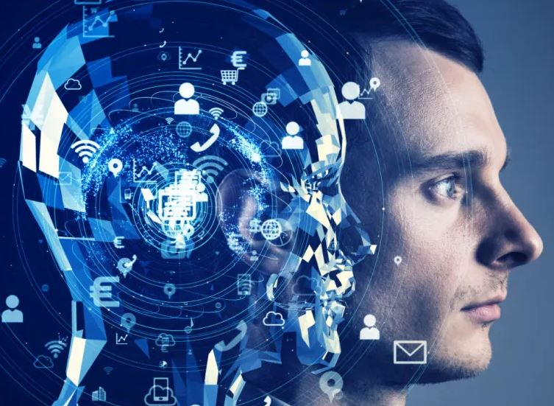
Recommendations
Integrate AI as supplementary tools, not replacements
Train teachers to use AI effectively
Develop hybrid curriculum models
Preserve human mentorship while embracing technology
The future of education shall be collaborative, not competitive

Slide 13
THANK YOU
Questions?
Special Thanks:
Ms. Ramsha Khalid (Instructor)
All Survey Participants

